Slide 1
Wi-Fi Design

Slide 2
Implementing a Wi-Fi Network
This section describes:
WLAN technologies and how to design small WLANs
How to install and configure access points and clients on larger networks

Slide 3
Determine the Design (1 of 4)
Home or small office network, called a SOHO network, might call for only one access point
The AP device often combines switching, routing, and other network functions
It connects wireless clients to LAN and acts as an Internet gateway
Many home or office networks include IoT (Internet of Things) devices

Slide 4
Determine the Design (1 of 4)
Examples of IoT devices that might be a part of a home or office network include the following:
Health monitors, exercise equipment, GPS locators, and smartwatches
Smart speakers
Smart thermostats
Smart doorbells
Security cameras
Smart refrigerators

Slide 5
Determine the Design (2 of 4)
Consider the following when deciding where to install an AP:
Distance
Type and number of obstacles
Coverage
Interference
Larger WLANs warrant a more systematic approach to access point placement
A site survey assesses client requirements, facility characteristics, coverage areas
A site survey will help determine access point arrangement ensuring reliable wireless connectivity within a given area

Slide 6
Determine the Design (3 of 4)
A thorough site survey might include:
Studying building blueprints to identify potential obstacles
Consider whether Wi-Fi access points will be used as wireless bridges to create remote wired access to the network
Determine whether certain floors require multiple APs
Measure the signal coverage and strength from other WLANS
Test proposed access point locations
Test wireless access from the farthest corners of your space
Consider the materials used in objects that aren’t always present in the environment
Consider how the wireless portions of the LAN will integrate with the wired portions

Slide 7
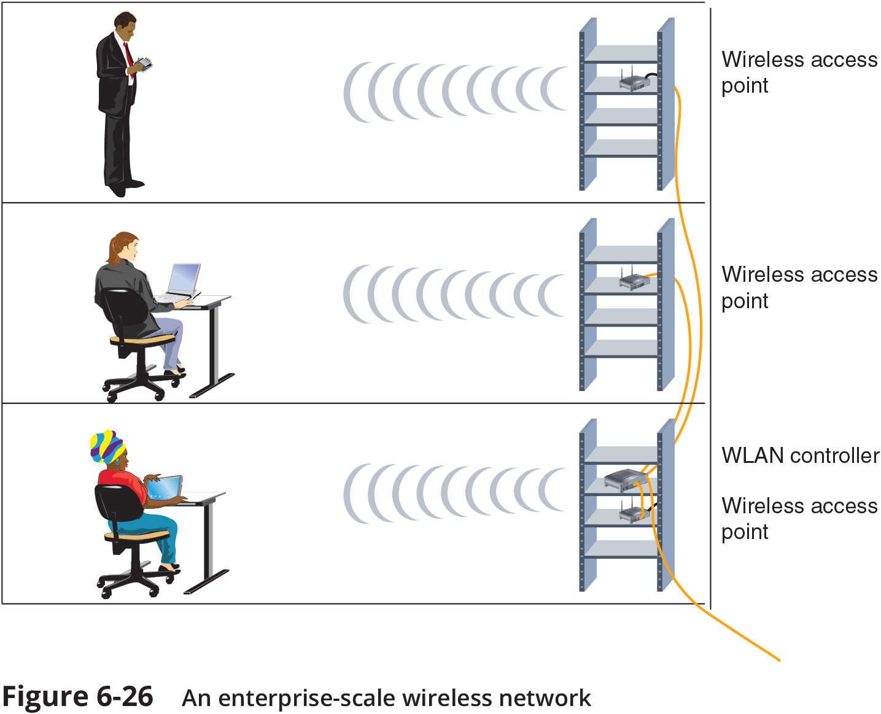
Determine the Design (4 of 4)

Slide 8
Configure Wi-Fi Connectivity Devices
APs vary in which wireless standards they support, their antenna strength, and other features
Variables set during installation include the following:
Administrator password
SSID and whether or not the SSID is broadcast
Security options
Whether or not DHCP is used
If something goes awry during your SOHO router configuration, you can force a reset of all the variables you changed

Slide 9
Configure Wi-Fi Clients
Configuration varies from one client type to another
As long as an AP is broadcasting its SSID, clients in its vicinity will detect it and offer the user the option to associate with it
On-boarding – involves installing a specific program or app onto a device to give it trusted access to certain portions of the network
Off-boarding – involves removing programs that gave devices special permissions on the network
Administrators need a feature that allows them to off-board remotely (in case AP is lost or stolen)
This feature is called a remote wipe

